Slide 1
Deep Learning

Slide 2
Perceptron
One of the simplest ANN architecture, invented in 1957 by Frank Rosenblatt
TLU ->

Slide 3
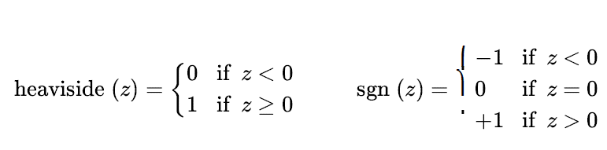
The most common step function in perceptron is the heaviside function.
An single TLU can be used for linear binary classification task.
A perceptron is composed of one of more TLUs organized in a single layer

Slide 4
Architecture of a Perceptron

Slide 5

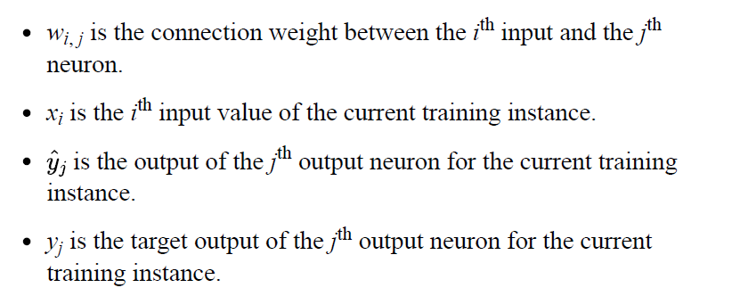

Learning rule

Slide 6
Limitations
The decision boundary of each output neuron is linear, so Perceptrons are incapable of learning complex patterns
However, if the training instances are linearly separable, `Rosenblatt demonstrated that the alg will converge to a solution.

Slide 7
Scikit-learn’s perceptron

Slide 9
Deep Neural Networks
When an ANN contains a deep stack of hidden layers, it is called a deep neural network (DNN).
The field of Deep Learning studies DNNs, and more generally it is interested in models containing deep stacks of computations
In the early 1960s, several researchers discussed the possibility to use Gradient Descent to train neural networks
Reverse-mode automatic differentiation (or reverse-mode autodiff for short) was introduced by Seppo Linnainmaa, in his master thesis.
In just two passes through the network (one forward, one backward), it is able to compute the gradients of the neural network’s error with regard to every single model parameter.

Slide 10
Backpropagation
It handles one mini-batch at a time (for example, containing 32 instances each), and it goes through the full training set multiple times. Each pass is called an epoch.
Each mini-batch enters the network through the input layer. The algorithm then computes the output of all the neurons in the first hidden layer, for every instance in the mini-batch. The result is passed on to the next layer, and so on until we get the output of the last layer, the output layer.
This is the forward pass: it is exactly like making predictions, except all intermediate results are preserved since they are needed for the backward pass.

Slide 11
Next, the algorithm measures the network’s output error (i.e., it uses a loss function that compares the desired output and the actual output of the network, and returns some measure of the error).
Then it computes how much each output bias and each connection to the output layer contributed to the error. This is done analytically by applying the chain rule
The algorithm then measures how much of these error contributions came from each connection in the layer below, again using the chain rule, working backward until the algorithm reaches the input layer.
Finally, the algorithm performs a Gradient Descent step to tweak all the connection weights in the network, using the error gradients it just computed.

Slide 12
Switch to Sigmoid
In order for backprop to work properly, step function was replaced with the logistic function, σ(z) = 1 / (1 + exp(–z)), also called the sigmoid function.
the sigmoid function has a well-defined nonzero derivative everywhere, allowing Gradient Descent to make some progress at every step.

Slide 13
Other Activation Functions
The hyperbolic tangent function: tanh(z) = 2σ(2z) – 1
Just like the sigmoid function, this activation function is S-shaped, continuous, and differentiable, but its output value ranges from –1 to 1 (instead of 0 to 1 in the case of the sigmoid function). That range tends to make each layer’s output more or less centered around 0 at the beginning of training, which often helps speed up convergence

Slide 14
Other Activation Functions
The Rectified Linear Unit function: ReLU(z) = max(0, z)
The ReLU function is continuous but unfortunately not differentiable at z = 0 (the slope changes abruptly, which can make Gradient Descent bounce around), and its derivative is 0 for z < 0. In practice, however, it works very well and has the advantage of being fast to compute, so it has become the default. Importantly, the fact that it does not have a maximum output value helps reduce some issues during Gradient Descent

Slide 16
Why do we need activation functions
Well, if you chain several linear transformations, all you get is a linear transformation.
if f(x) = 2x + 3 and g(x) = 5x – 1, then chaining these two linear functions gives you another linear function:
f(g(x)) = 2(5x – 1) + 3 = 10x + 1
Conversely, a large enough DNN with nonlinear activations can theoretically approximate any continuous function.

Slide 17
Regression MLPs
First, MLPs can be used for regression tasks. If you want to predict a single value (e.g., the price of a house, given many of its features), then you just need a single output neuron
For multivariate regression (i.e., to predict multiple values at once), you need one output neuron per output dimension.
Scikit-Learn includes an MLPRegressor class

Slide 18
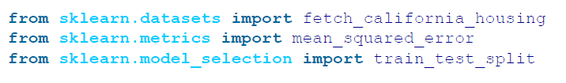
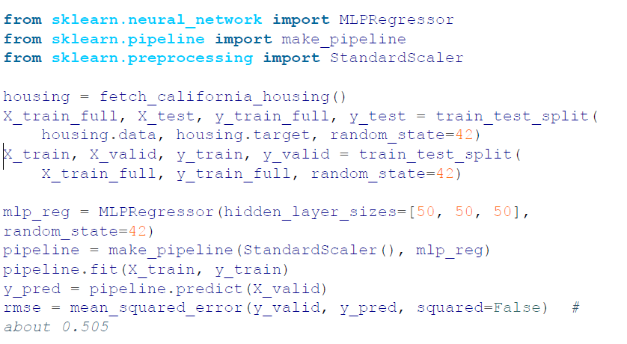

Slide 19
Note that this MLP does not use any activation function for the output layer,
But if you want to guarantee that the output will always be positive, then you should use the ReLU activation function in the output layer, or the softplus activation function, which is a smooth variant of ReLU: softplus(z) = log(1 + exp(z)).
Softplus is close to 0 when z is negative, and close to z when z is positive.
Finally, if you want to guarantee that the predictions will always fall within a given range of values, then you should use the sigmoid function or the hyperbolic tangent, and scale the targets to the appropriate range: 0 to 1 for sigmoid and –1 to 1 for tanh.
Sadly, the MLPRegressor class does not support activation functions in the output layer.

Slide 20
Keras
Building and training a standard MLP with Scikit-Learn in just a few lines of code is very convenient, but the neural net features are limited. This is why we will switch to Keras in the second part of this chapter.

Slide 21
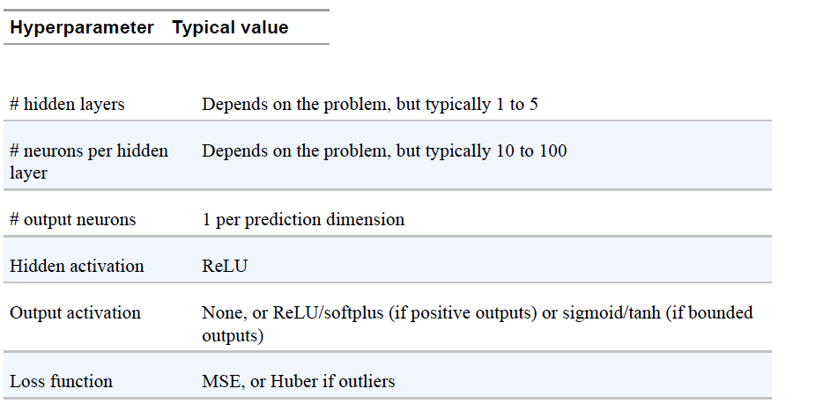

Slide 22
Classification MLPs
MLPs can also be used for classification tasks. For a binary classification problem, you just need a single output neuron using the sigmoid activation function: the output will be a number between 0 and 1, which you can interpret as the estimated probability of the positive class
More generally, you would dedicate one output neuron for each positive class. Note that the output probabilities do not necessarily add up to 1.
If each instance can belong only to a single class, out of three or more possible classes (e.g., classes 0 through 9 for digit image classification), then you need to have one output neuron per class, and you should use the softmax activation function for the whole output layer

Slide 24
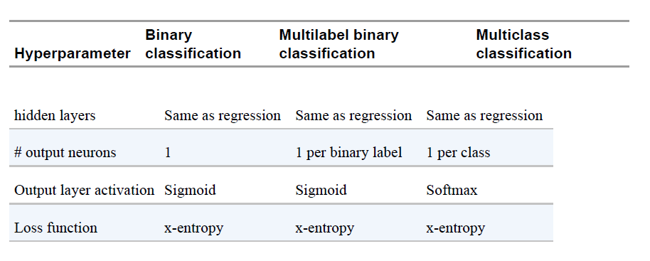
Typical Hyperparameters

Slide 25
Implementing MLP with Keras
Keras is TensorFlow’s high-level Deep Learning API: it allows you to build, train, evaluate, and execute all sorts of neural networks.
The most popular Deep Learning library, after Keras and TensorFlow, is Facebook’s PyTorch library. The good news is that its API is quite similar to Keras’s, in part because both APIs were inspired by Scikit-Learn and Chainer. So once you know Keras, it is not difficult to switch to PyTorch, if you ever want to

Slide 26
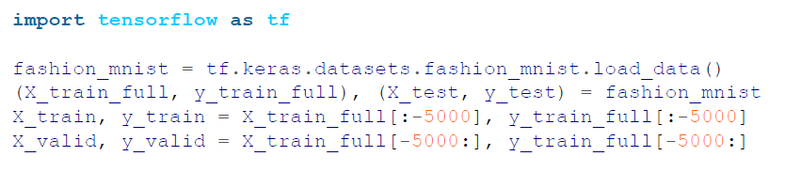
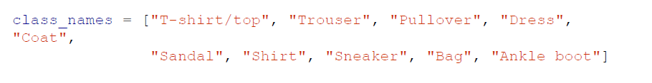

Building an Image Classifier Using the Sequential API

Slide 28
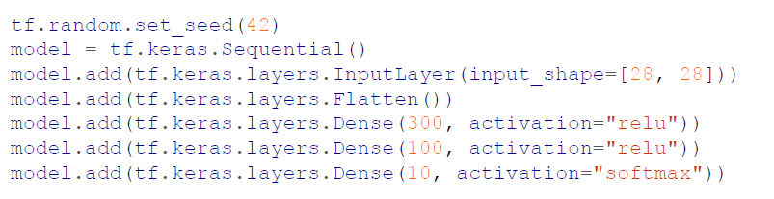
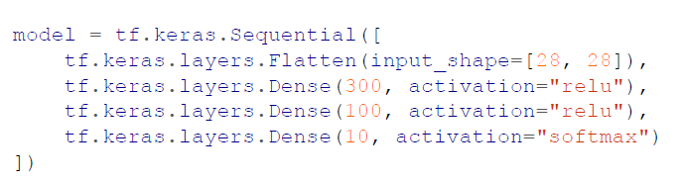
Creating a model with the sequencial api

Slide 29
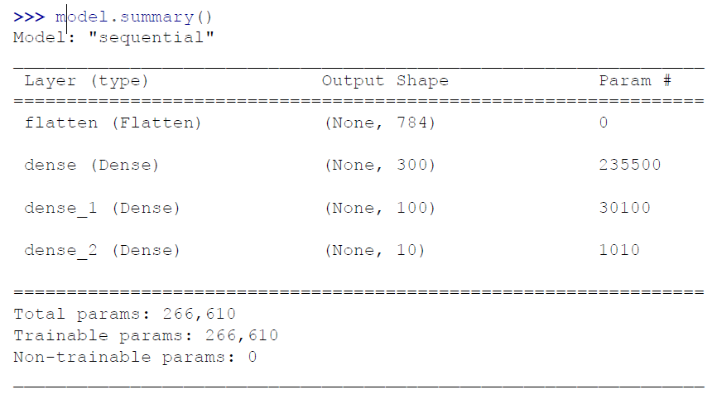
Summary

Slide 30
Model deep dive
can easily get a model’s list of layers using the layers attribute, or use the get_layer() method to access a layer by name
All the parameters of a layer can be accessed using its get_weights() and set_weights() methods. For a Dense layer, this includes both the connection weights and the bias terms

Slide 31
Model Deep dive
Notice that the Dense layer initialized the connection weights randomly (which is needed to break symmetry, as we discussed earlier), and the biases were initialized to zeros, which is fine.
If you ever want to use a different initialization method, you can set kernel_initializer (kernel is another name for the matrix of connection weights) or bias_initializer when creating the layer

Slide 32
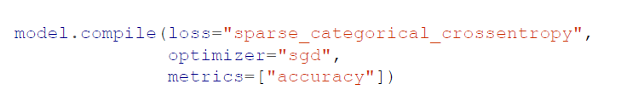
Compiling the model

Slide 33
Compiling the model
"sparse_categorical_crossentropy“for sparse labels (i.e., for each instance, there is just a target class index, from 0 to 9 in this case), and the classes are exclusive
If instead we had one target probability per class for each instance (such as one-hot vectors, e.g. [0., 0., 0., 1., 0., 0., 0., 0., 0., 0.] to represent class 3), then we would need to use the "categorical_crossentropy" loss instead.
If we were doing binary classification or multilabel binary
classification, then we would use the "sigmoid" activation function in
the output layer instead of the "softmax" activation function, and we
would use the "binary_crossentropy" loss.

Slide 34
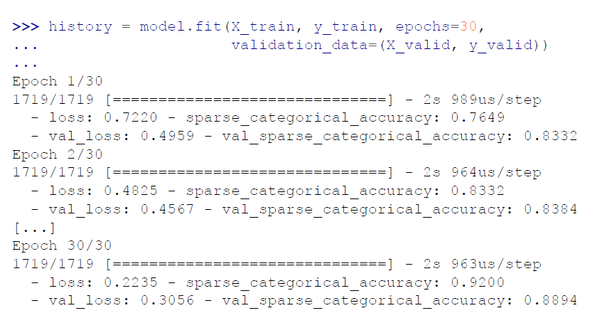
Training and evaluating the model

Slide 35
Dealing with skewed data
If the training set was very skewed, with some classes being overrepresented and others underrepresented, it would be useful to set the class_weight argument when calling the fit() method, to give a larger weight to underrepresented classes and a lower weight to overrepresented classes.

Slide 36
Sample Weights argument
If you need per-instance weights, set the sample_weight argument. If both class_weight and sample_weight are provided, then Keras multiplies them. Per-instance weights could be useful for example if some instances were labeled by experts while others were labeled using a crowdsourcing platform: you might want to give more weight to the former. You can also provide sample weights (but not class weights) for the validation set by adding them as a third item in the validation_data tuple.

Slide 37
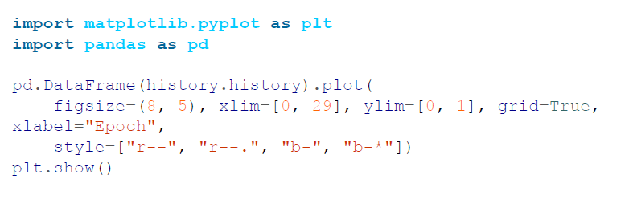
History

Slide 39
Insights
Both the training accuracy and the validation accuracy steadily increase during training, while the training loss and the validation loss decrease.
The validation curves are relatively close to each other at first, but they get further apart over time, which shows that there’s a little bit of overfitting.
But that’s not the case: indeed, the validation error is computed at the end of each epoch, while the training error is computed using a running mean during each epoch. So the training curve should be shifted by half an epoch to the left.

Slide 40
Insights
You can tell that the model has not quite converged yet, as the validation loss is still going down, so you should probably continue training. It’s as simple as calling the fit() method again, since Keras just continues training where it left off.
If you are not satisfied with the performance of your model, you should go back and tune the hyperparameters like learning rate, optimizers. Then try tuning the number of layers, the number of neurons per layer, and the types of activation functions to use for each hidden layer

Slide 41
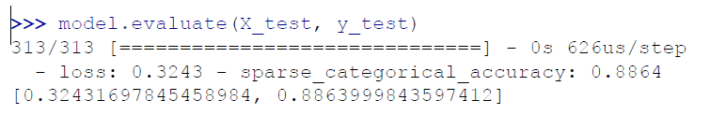
Evaluate
Once you are satisfied with your model’s validation accuracy, you should evaluate it on the test set to estimate the generalization error before you deploy the model to production.

Slide 42
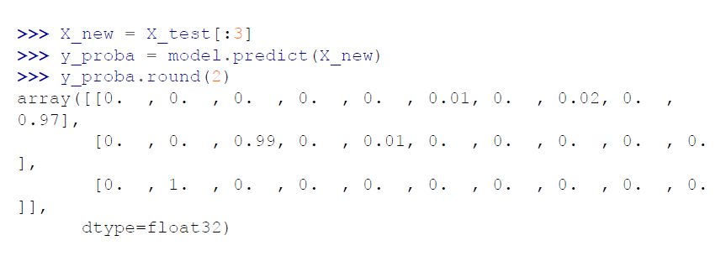
Make Predictions

Slide 43
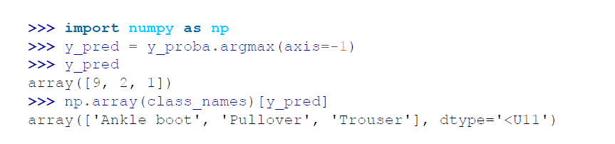
Make Predictions

Slide 44
Building a Regression MLP Using the Sequential API
Quite similar to what we did for classification
the output layer has a single neuron (since we only want to predict a single value)
it uses no activation function, the loss function is the mean squared error, the metric is the RMSE
Moreover, in this example we don’t need a Flatten layer, and instead we’re using a Normalization layer as the first layer

Slide 45
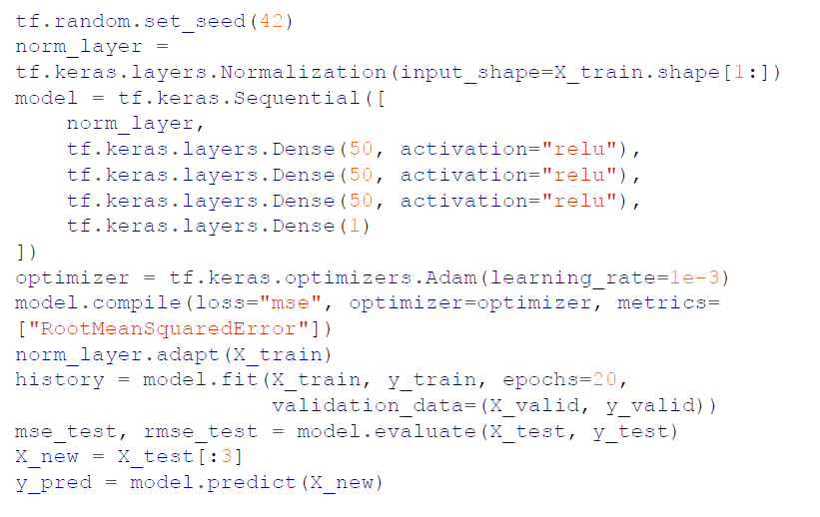

Slide 46
The Functional API
As you can see, the Sequential API is quite clean and straightforward.
However, although Sequential models are extremely common, it is sometimes useful to build neural networks with more complex topologies or multiple inputs or outputs. For this purpose, Keras offers a Functional API.

Slide 47
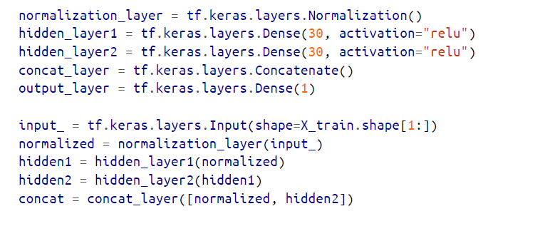
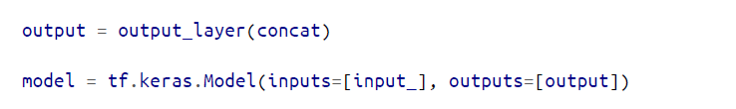
Building Complex Models Using the Functional API

Slide 48
Building a complex model with the functional API

Slide 49
Another Architecture

Slide 50
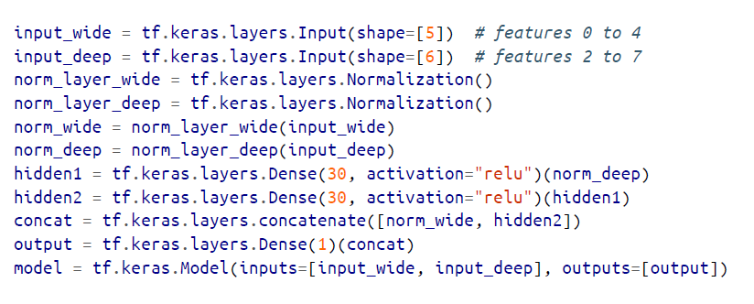
Another Architecture

Slide 51
Cases for Multiple output layer
The task may demand it. For instance, you may want to locate and classify the main object in a picture. This is both a regression tasks and a classification task.
Similarly, you may have multiple independent tasks based on the same data. Sure, you could train one neural network per task, but in many cases you will get better results on all tasks by training a single neural network with one output per task.
Another use case is as a regularization technique

Slide 53
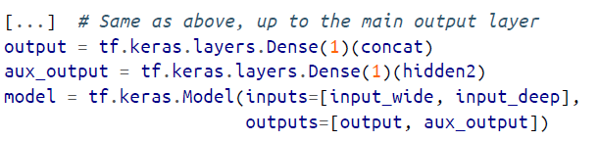
Multiple output layer

Slide 54
Using the Subclassing API to Build Dynamic Models
Some models involve loops, varying shapes, conditional branching, and other dynamic behaviors. For such cases, or simply if you prefer a more imperative programming style, the subclassing API is for you.

Slide 55
Using the Subclassing API to Build Dynamic Models
This makes it a great API when experimenting with new ideas, especially for researchers. However, this extra flexibility does come at a cost:
Your model’s architecture is hidden within the call() method, so Keras cannot easily inspect it
The model cannot be cloned using tf.keras.models.clone_model(); and when you call the summary() method, you only get a list of layers, without any information on how they are connected to each other.
Moreover, Keras cannot check types and shapes ahead of time, and it is easier to make mistakes. So unless you really need that extra flexibility, you should probably stick to the sequential API or the functional API.

Slide 56
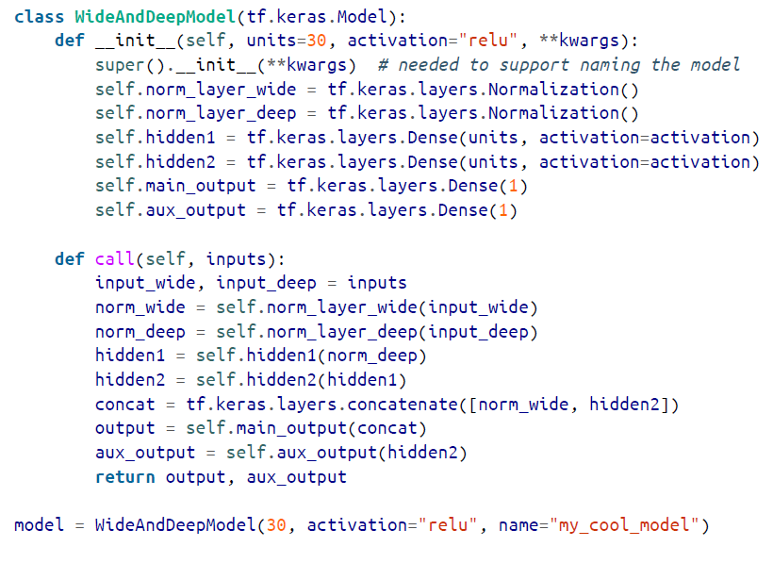

Slide 57

Saving and loading models
model.save("my_keras_model", save_format="tf")
When you set save_format="tf", Keras saves the model using TensorFlow’s SavedModel format: this is a directory (with the given name) containing several files and subdirectories
You will typically have a script that trains a model and saves it, and one or more scripts (or web services) that load the model and use it to evaluate it or to make predictions.

Slide 58
Saving weights
You can also use save_weights() and load_weights() to save and load only the parameter values.
Saving just the weights is faster and uses less disk space than saving the whole model, so it’s perfect to save quick checkpoints during training. If you’re training a big model, and it takes hours or days, then you must save checkpoints regularly in case the computer crashes.
But how can you tell the fit() method to save checkpoints? Use callbacks.

Slide 59
Using Tensorboard
TensorBoard is a great interactive visualization tool that you can use to view the learning curves during training, compare curves and metrics between multiple runs, visualize the computation graph, analyze training statistics, view images generated by your model, visualize complex multidimensional data projected down to 3D and automatically clustered for you, profile your network (i.e., measure its speed to identify bottlenecks), and more!

Slide 61
Fine tuning the Hyperparameters
One option is to convert your Keras model to a Scikit-Learn estimator, and then use GridSearchCV or RandomizedSearchCV to fine-tune the hyperparameters
However, there’s a better way: you can use the Keras Tuner library, which is a hyperparameter tuning library for Keras models.

Slide 62
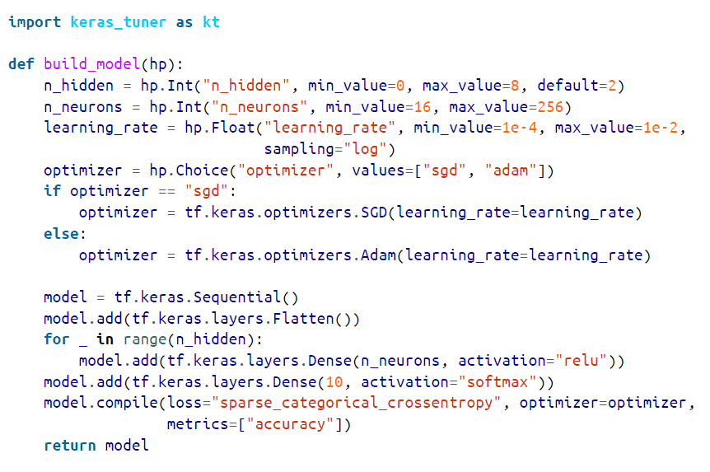

Slide 63
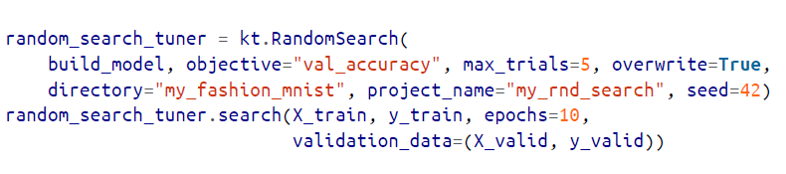
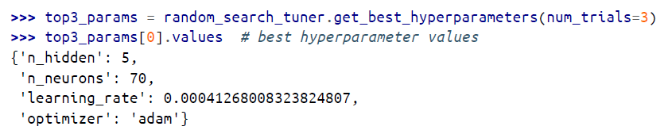

Slide 64
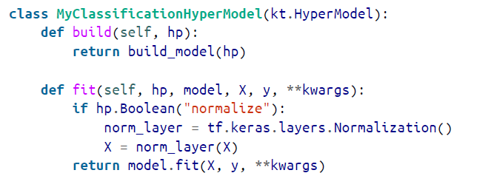
fine-tune data preprocessing hyperparameters, or model.fit() arguments
instead of writing a build_model() function, you must subclass the kt.HyperModel class and define two methods, build() and fit()

Slide 65
Number of hidden layers
An MLP with just one hidden layer can theoretically model even the most complex functions, provided it has enough neurons.
But for complex problems, deep networks have a much higher parameter efficiency than shallow ones: they can model complex functions using exponentially fewer neurons than shallow nets, allowing them to reach much better performance with the same amount of training data.

Slide 66
Number of Neurons per Hidden Layer
The number of neurons in the input and output layers is determined by the type of input and output your task requires.
Just like the number of layers, you can try increasing the number of neurons gradually until the network starts overfitting. Alternatively, you can try building a model with slightly more layers and neurons than you actually need, then use early stopping and other regularization techniques to prevent it from overfitting too much

Slide 67
Learning Rate
The optimal learning rate is about half of the maximum learning rate (i.e., the learning rate above which the training algorithm diverges).
One way to find a good learning rate is to train the model for a few hundred iterations, starting with a very low learning rate (e.g., 10 ) and gradually increasing it up to a very large value (e.g., 10).
This is done by multiplying the learning rate by a constant factor at each iteration (e.g., by (10 / 10 ) to go from 10 to 10 in 500 iterations). If you plot the loss as a function of the learning rate (using a log scale for the learning rate), you should see it dropping at first.
But after a while, the learning rate will be too large, so the loss will shoot back up: the optimal learning rate will be a bit lower than the point at which the loss starts to climb

Slide 68
Optimizer
Choosing a better optimizer than plain old mini-batch gradient descent (and tuning its hyperparameters) is also quite important.

Slide 69
Batch size
The batch size can have a significant impact on your model’s performance and training time. The main benefit of using large batch sizes is that hardware accelerators like GPUs can process them efficiently
One strategy is to try to using a large batch size, with learning rate warmup, and if training is unstable or the final performance is disappointing, then try using a small batch size instead.

Slide 70
Activation function
in general, the ReLU activation function will be a good default for all hidden layers, but for the output layer it really depends on your task.

Slide 71
# of iterations
In most cases, the number of training iterations does not actually need to be tweaked: just use early stopping instead

Slide 72
Exercise
Train a deep MLP on the MNIST dataset (you can load it using tf.keras. data⁠sets.mnist.load_data()).
See if you can get over 98% accuracy by manually tuning the hyperparameters.
Try searching for the optimal learning rate by using the approach presented (i.e., by growing the learning rate exponentially, plotting the loss, and finding the point where the loss shoots up). Next, try tuning the hyperparameters using Keras Tuner with all the bells and whistles —save checkpoints, use early stopping, and plot learning curves using TensorBoard.

